Slide 1
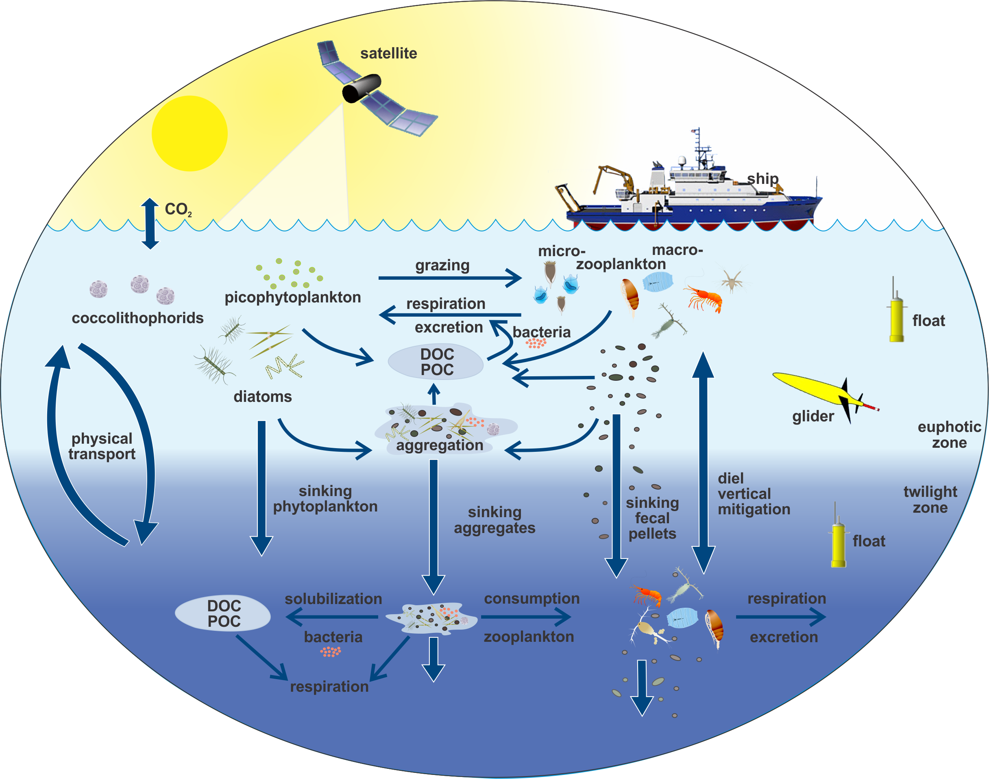
EXPORTS
EXport Processes in the Ocean from RemoTe Sensing
EXPORTS Writing Team: Mike Behrenfeld (OSU), Claudia Benitez-Nelson (USoCar), Emmanuel Boss (UMaine), Mark Brzezinski (UCSB), Ken Buesseler (WHOI), Adrian Burd (UGA), Craig Carlson (UCSB), Eric D’Asaro (UW), Scott Doney (WHOI), Mary Jane Perry (UMaine), Dave Siegel (UCSB), Rachel Stanley (WHOI), Deb Steinberg (VIMS)
http://cce.nasa.gov/cce/ocean_exports_intro.htm
Notes:
Science plan for a major NASA field campaign focused on predicting the state of the biological carbon pump from satellite observations

Slide 2
What is EXPORTS?
A community-vetted science plan for a
NASA field campaign
Goal: Predict the export & fate of ocean NPP from satellite & other observations
Hypothesis: Fate of ocean NPP is regulated by the state of the surface ecosystem
Final EXPORTS Science Plan is under consideration for implementation at NASA
Notes:
Science plan for a major NASA field campaign focused on predicting the state of the biological carbon pump from satellite observations

Slide 3
Why EXPORTS?
Notes:
The biological pump is complicated. Many processes on a range of scales. Some our seen from satellite most are not. Need to constrain the biological pump and that ~10 Pg C that flows thru it each year from satellite observations.

Slide 4

Why? Need to understand, quantify & predict how ecosystem processes transfer organic matter to depth
Notes:
This provides pathways for rapid carbon sequestration. Uncertainties in all parts are as big as the signals themselves.

Slide 5

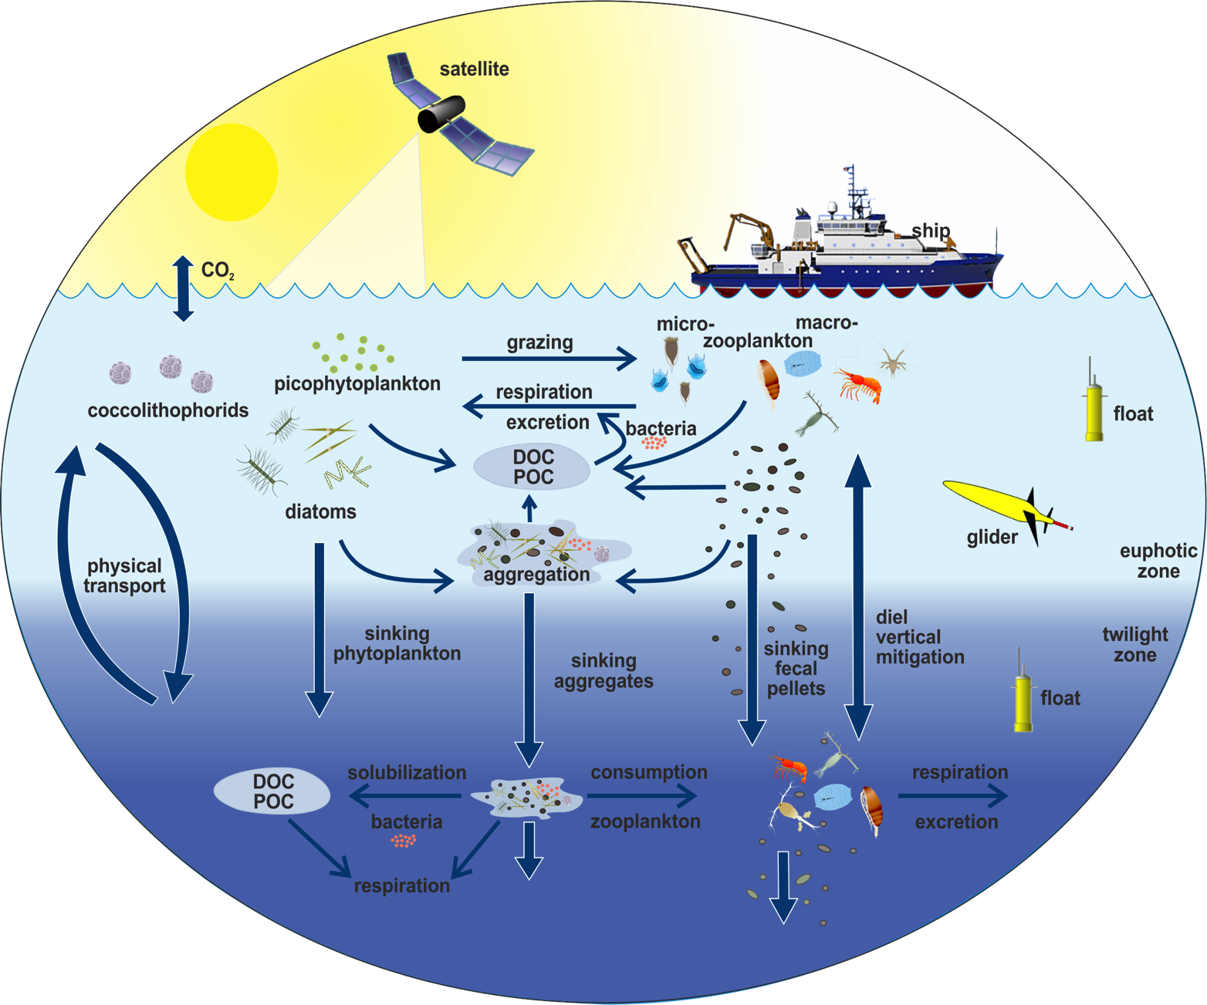
Need to improve estimates of carbon export from the euphotic zone (4 to 13 Pg C y⁻¹)
Physical Transport
0.5 - 2.5 Pg C y⁻¹
Sinking Flux
4 - 8 Pg C y⁻¹
Migration Flux
0.5 - 1.5 Pg C y⁻¹
Notes:
There are three major pathways – Left to right – 1) Physical transport of DOC/POC to depth where it is utilized, 2) Sinking particle fluxes and 3) vertical migration that removes organic matter from the surface ocean and transports it to depth.
We have a fair understanding of the flux pathways but again only within a factor of two.

Slide 6

Why? Need to quantify the attenuation of export below euphotic zone (the twilight zone)
Notes:
There are large uncertainties in carbon sequestration times.

Slide 7

Why Now? Advances in remote sensing (& PACE!!) & autonomous tools make it time!
Notes:
Talk about PACE mission. One of the stated goals of PACE is to understand the global carbon cycle. In many ways EXPORTS provides the needed information to begin to constrain the fate of organic carbon in the global ocean.

Slide 8
EXPORTS: Three Science Questions
How do upper ocean ecosystem characteristics determine the vertical transfer of organic matter from the well-lit surface ocean?
What controls the efficiency of vertical transfer of organic matter below the well-lit surface ocean?
How can the knowledge gained be used to reduce uncertainties in contemporary & future estimates of the export and fates of NPP?
Notes:
The three over arching science questions each have four specific sub questions. The EPORTS Science Plan addresses how eachwill be answered.

Slide 9
EXPORTS: Focus on Pathways
North Atlantic Bloom
Northeast Pacific Summer
Needed for building models & predicting present & future states of NPP export & fate
Goal: Predict the export & fate of ocean NPP from satellite (& potentially other) observations
Notes:
Wiring diagram.

Slide 10
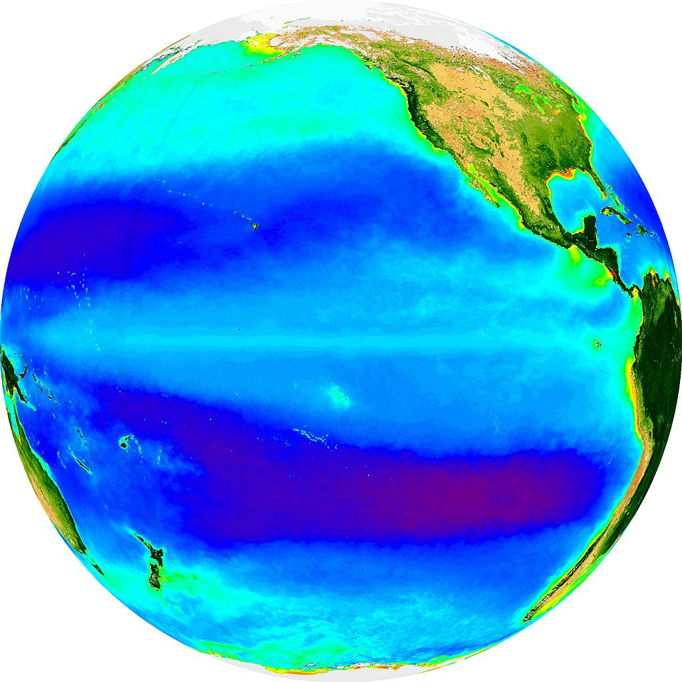
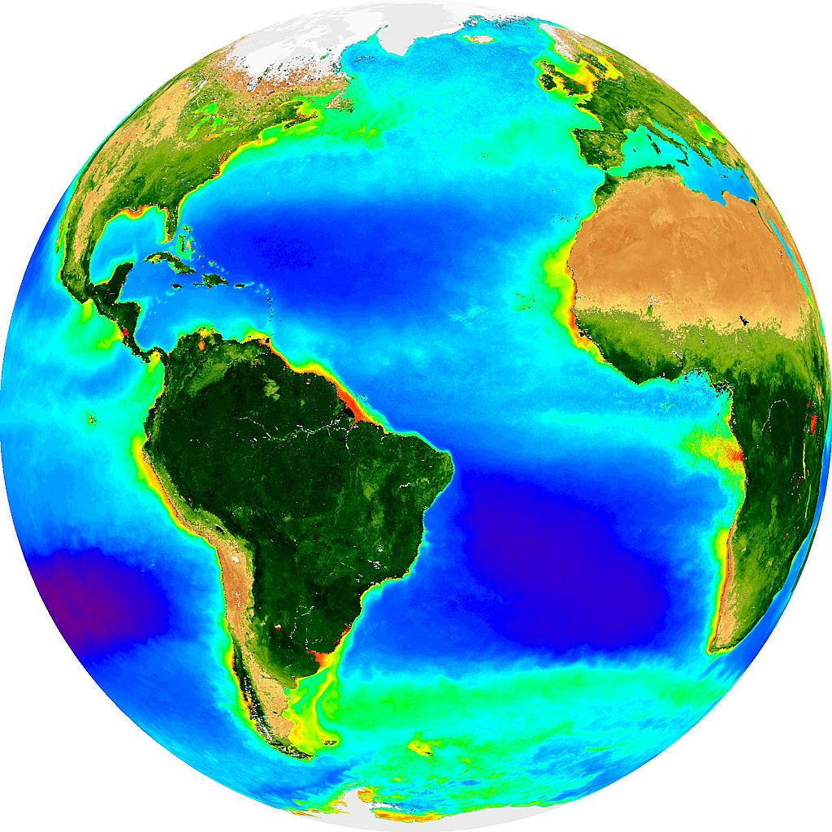
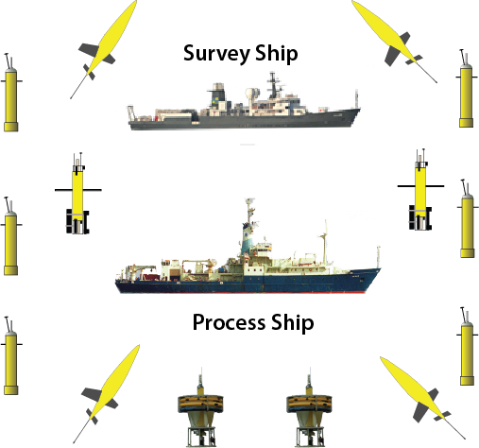
EXPORTS: Notional Implementation
Station P
North Atlantic
Spatial Ship
Lagrangian Ship
Cruise 1: April/May 30/45d Cruise 2: Aug, 30d
Leverage: OOI node, LineP
Bloom: April/May 45 d
Non-bloom: Aug, 30d
Leverage: Internationals
Will collect ~8 ecosystem / C cycling states
Supplement by data mining existing results
Notes:
The goal is to observe contrasting states of the pump.
The plan is for two major field campaigns in two ocean sites(4 cruises in total). Each cruise will be long enough to see two complete states of the biological pump – resulting in 8 in total.
Each cruise is designed to observe contrasting states of the biological pump and to utilize available partnerships.
Significant efforts will also be made to synthesize existing results by data mining – We expect this to greatly increase the numbers of degrees of freedom to model with.

Slide 11
EXPORTS: Notional Implementation
Particle-Following
from production to trap
Measure C cycling fluxes from 0 to 500 m (over 10 d)
Water-Following
follow instrumented mixed layer float(s?)
Spatial Ship
Submeso- & meso-scale surveys (5-200 km)
Deploy short-term assets
Lagrangian Ship
Measure rates & transformations
Long Term Presence
Profiling Floats & Satellites
BioARGO, PSD & export proxy
Annual BGC budgeting
O₂, NO₃, DOC, DIC, etc.
Optimize Spatial Sampling
Gliders surveying (5-100 km)
Bio-optical proxies
Satellite sampling
Ocean color & supporting info
Notes:
The cruise plan is to follow water parcels as the advect along with mixed layer floats and follow particles from their production to collection in sediment traps. That sets the time scale over which a “state” of the pump can be characterized – 10 days.
There will be two ships – one following the mixed layer float and sampling rates/transformations and other conducting submeso- to mesoscale surveys around int.
Long term presence is maintained with profiling floats and annual BGC budgeting
Spatial surveying is augmented with gliders and satellite observations.

Slide 12
6F
3F
3F
Floats
Gliders
Process
EXPORTS
Starts
NE Pac
May
[35 S]
[30 L]
Oct
[35 S]
[30 L]
Mar
[12]
Data mine
Modeling
Jan
[12]
data process/regroup
2017
2018
2019
Autonomous Assets
Floats: 3 types (Bio-Argo; PSD; flux)
Gliders: 2-Meso- & 2-Process-scale
Process: ML float, TS traps
NE Atl
Apr/May
[50 S]
[45 L]
Aug
[35 S]
[30 L]
Mar
[10]
Jan
[10]
EXPORTS
Ends
5 years
data process/ synthesis
2020
2021
= Process & Survey Cruises - includes multi depth trapping, rates, tow-yo SMS mapping, zooplankton tows, full bio-optics, etc.
= deploy autonomous assets
= recover autonomous assets

Slide 13

EXPORTS: Observables
Ecosystem Structure: Community Characteristics

Slide 14

EXPORTS: Observables
Ecosystem Function: Physiology, rates, processes

Slide 15

EXPORTS: Observables
Multiple paths to export & its attenuation with depth

Slide 16

EXPORTS: Observables
Water Column Characterization
Ocean Optics:
R_{rs}(λ), E_{d}(z,λ), IOP’s, PSD, etc.
Biogeochemistry:
Nuts, DIC, DOC, POC, PIC, etc.
Physical Oceanography:
T, S, horizontal velocity, etc.

Slide 17
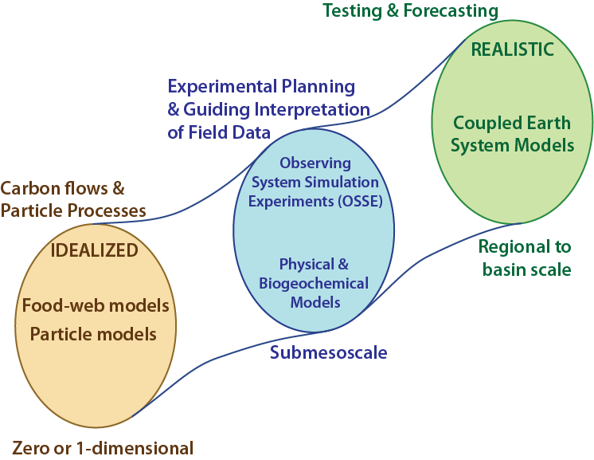
EXPORTS: Numerical Modeling

Slide 18
EXPORTS: Technical Readiness
EXPORTS can answer its science questions with present technology
Improvements that would be nice…
Experimental Logistics:
OSSE’s & tools for coordinating sampling, etc.
Rapid Plankton Characterization:
-omics, imaging, acoustics, cell sorting, etc.
Sensors for Autonomous Platforms:
Zooplankton abundance/composition, DIC, DOC, PSD, etc.
Optical Instrumentation (aimed for PACE):
Hyperspectral reflectance, UV IOP’s, etc.

Slide 19
EXPORTS Notional Budget: $53M, 5 years
Other:
Logistics, project/data man, etc.
$5.8 million
Autonomous Array:
6 × 4 floats
6 gliders (4 spares)
2 ML floats (1 spare)
9 traps (3 spares)
$5.3 million
12%
10%
52%
25%
Ships:
NE Pacific (154 d)
N Atlantic (180 d)
$13.8 million
Investigators:
20 PI groups & equipment
$27 million

Slide 20
EXPORTS: Notional Budget
Yes, this is a large request. BUT $53 million is in line with many NASA field campaigns & U.S. JGOFS process studies
De-Re-scoping: Modularity of the EXPORTS science plan makes this easier & options will be proposed
Partnering will be critical: Both the U.S. & international & will be explored once EXPORTS is approved

Slide 21
EXPORTS: Notional Implementation
PACE LRD??
UNOFFICIAL – NOT APPROVED!!!
Notes:
This is only NOTIONAL. AND TOTALLY OPTIMISTIC!!!

Slide 22
EXPORTS: Next Steps
Final EXPORTS Science Plan has been submitted to NASA HQ and is available at: http://cce.nasa.gov/cce/ocean.htm?
A Science Definition Team will be competed shortly to write the EXPORTS Experimental Plan
If approved: Timeline has NASA AO’s in CY2016 with EXPORTS fieldwork starting in CY2017
Important: Every role in EXPORTS will be competed!!

Slide 23


Thank You for Your Attention!!
Special thanx our colleagues who have provided 100’s of comments on the draft EXPORTS Science Plan

